Slide 1
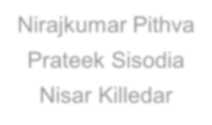
E - C O M M E R C E & R E TA I L B 2 B C A S E S T U D Y
Yogendra Shekhawat

Slide 2
Problem Statement
Schuster is a multinational retail company dealing in sports goods and accessories. Schuster conducts significant business with hundreds of its vendors, with whom it has credit arrangements. Unfortunately, not all vendors respect credit terms and some of them tend to make payments late. Schuster levies heavy late payment fees, although this procedure is not beneficial to either party in a long-term business relationship. The company has some employees who keep chasing vendors to get the payment on time; this procedure nevertheless also results in non-value-added activities, loss of time and financial impact. Schuster would thus try to understand its customers’ payment behavior and predict the likelihood of late payments against open invoices.

Slide 3
Objective
Schuster would like to better understand the customers’ payment behavior based on
their past payment patterns (customer segmentation).
Using historical information, it wants to be able to predict the likelihood of delayed
payment against open invoices from its customers.
It wants to use this information so that collectors can prioritize their work in following
up with customers beforehand to get the payments on time.

Slide 4
Solution Methodology
Reading and Understanding the data
Data Cleaning
Delete null values
Dropping columns which contains only one value
Dropping duplicated columns
Dropping columns which are not important for the analysis
Exploratory Data Analysis
Data imbalance check
Creating derived metrics (Ex: overdue_days, credit_period)
Clustering
Data Preparation
Outlier treatment
Creating dummy variables Feature scaling
Train Test split
Model Building
Model Evaluation
Conclusion
•
•
•
•
•
•

Slide 5
Grouped data
Grouped customers based on mean credit period and standard deviation of credit
period
Mean credit period is following a normal distribution
Standard deviation of credit period is skewed towards left
The average number of days from invoice date to due date is 38

Slide 6
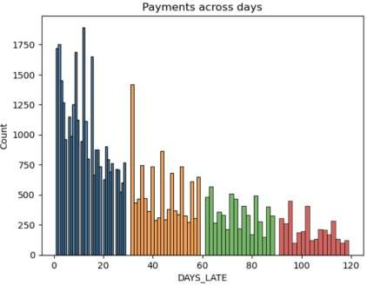
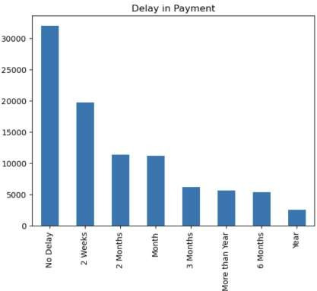
EDA
Delay in payment
Most of payments are cleared with no delay
2 weeks delayed payments are above the
average
Distribution of payments across due days

Slide 7
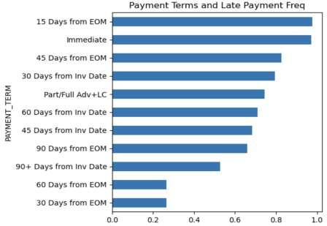
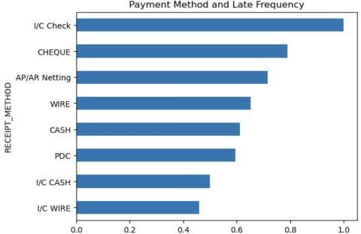
EDA
Late payment frequency by Payment
term
Late payment frequency by Payment
method

Slide 8
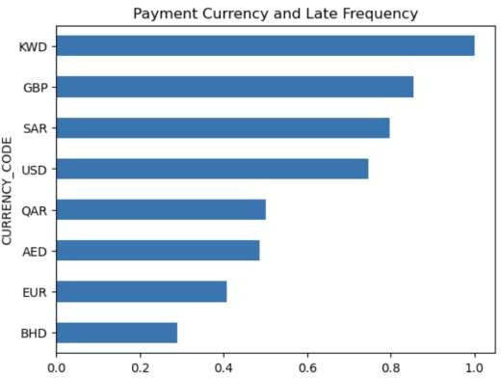
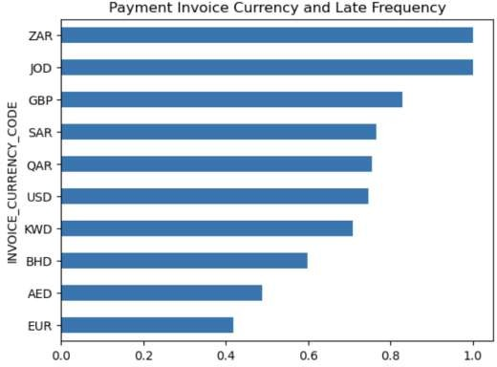
EDA
Late payment frequency by Payment
currency
Late payment frequency by Payment invoice
currency

Slide 9
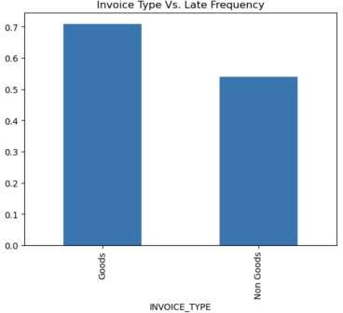
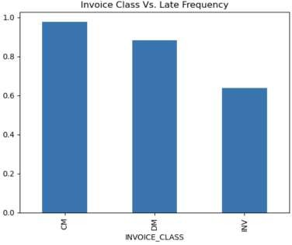
EDA
Late payment frequency by Invoice type
Late payment frequency by Invoice class

Slide 10
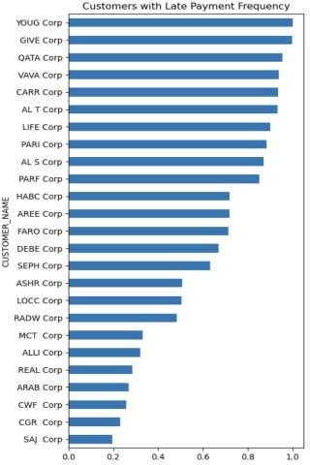
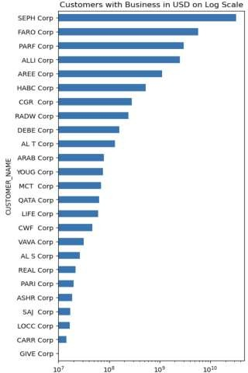
EDA
Late payment frequency by Customers
Customer count with Business in USD (log
scaled)

Slide 11
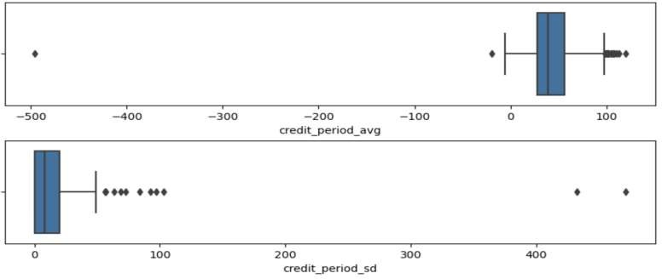
Outlier treatment and scaling
Used IQR(Inter Quartile Range) method to remove outliers and scaled the data using
Standard scalar method to do clustering

Slide 12
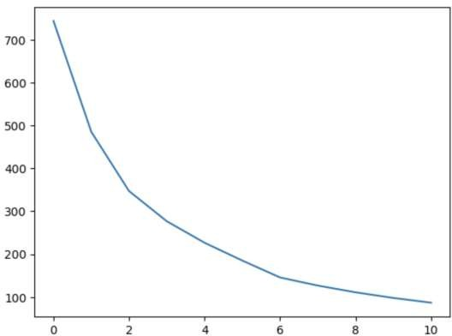
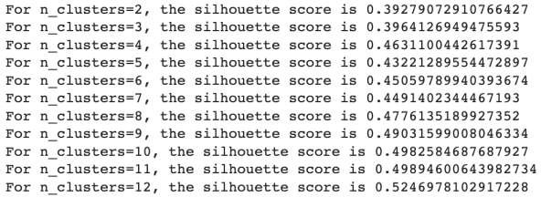
Customer segmentation
K-Means clustering on scaled data.
Elbow curve and Silhouette score to determine optimal cluster
Too many cluster will loose its importance so choosing k=5 by analyzing Silhouette score

Slide 13
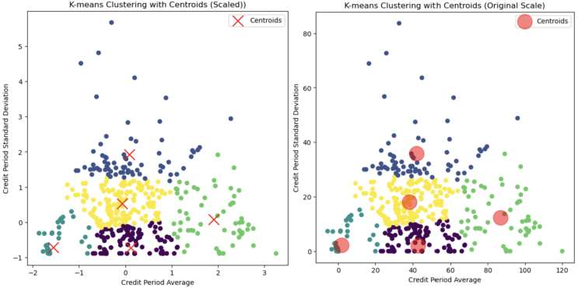
Clustering
There are clear 5 clusters of customers having different average payment days
Most of the customers are offered between
20 to 60 days of payment terms on an
average.(Blue, purple and yellow cluster)
When credit period is under 20 days on average, the variability in credit period is very less. (peacock blue cluster)
When credit period is more than 60 days on average, there is relatively moderage variability in the offered credit period (green cluster)
The variability is highest when credit period is between 20 to 60 days

Slide 14
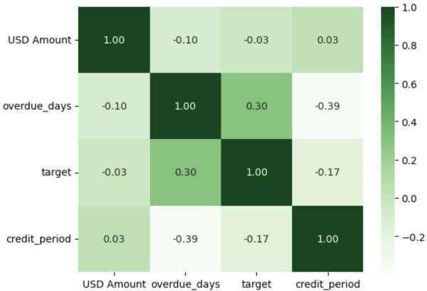
Correlation matrix

Slide 15
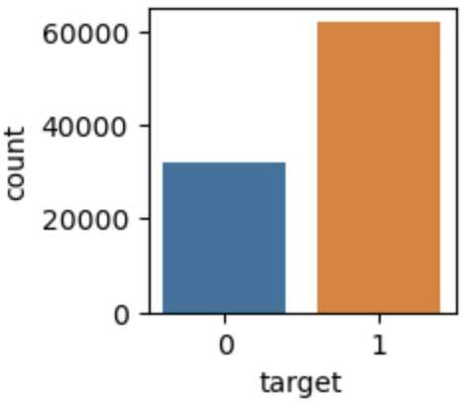
Class Imbalance and Data Preparation
Class imbalance by checking % of delayed and not delayed from target column
The dataset is moderately imbalanced with approx. 66% delayed and 34% not delayed

Slide 16
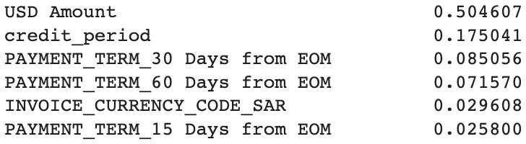
Feature selection
Selected top features which are >0.02, other columns are dropped as it does not
contribute much
Features and its importance

Slide 17
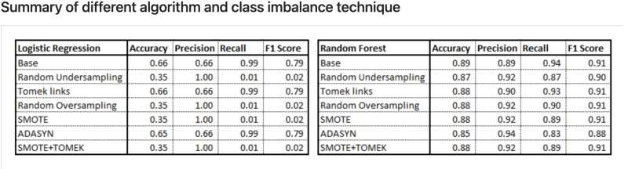
Class imbalance and Model selection
Here, Base (without implementing class imbalance technique) and Tomek links gives best result among all
other class imbalance techniques.
However, Random Forest performs much better with high Accuracy, Precision, Recall and F1 Score.
Logistic Regression has better Recall than Random Forest but much lower Accuracy and Precision.
So, we will go with Random Forest without implementing any class imbalance technique.
We have also seen earlier that the dataset in not highly skewed with 64% delayed payments and 36% not
delayed.

Slide 18
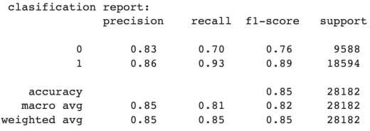
Random Forest model and Hyperparameter tuning
Hyperparameter tuning is achieved using GridsearchCV method
Model performance on the training data
Training accuracy- 84.7% Validation accuracy- 85% This clearly indicates the model is not overfitting
Confusion matrix
 | Positive | Negative
Positive | 6665 | 2923
Negative | 1319 | 17275
Model is giving very high accuracy, precision, recall and f1-score.
Out of these, recall is very high, which shows that model predicts very high proportion of delayed payments

Slide 19
Conclusion
The analysis identifies the top 10 contributors to delayed payments, with the highest impact factors being USD Amount, credit_period, and specific payment terms such as PAYMENT_TERM_30 Days from EOM and PAYMENT_TERM_60 Days from EOM. This suggests that addressing these factors could significantly reduce payment delays.
FEATURES | IMPORTANCE
USD Amount | 0.504607
Credit_Period | 0.175041
PAYMENT_TERM_30 Days from EOM | 0.085056
PAYMENT_TERM_60 Days from EOM | 0.071570
INVOICE_CURRENCY_CODE_SAR | 0.029608
PAYMENT_TERM_15 Days from EOM | 0.025800
INVOICE_CURRENCY_CODE_USD | 0.015757
PAYMENT_TERM_Immediate Payment | 0.014697
PAYMENT_TERM_60 Days from Inv Date | 0.011407
PAYMENT_TERM_Immediate | 0.011402

Slide 20
Recommendation
To improve the payment process, it is recommended that the client consider adopting milestone or
staggered invoicing strategies rather than waiting to invoice for the entire order at once.
Some of the best payment terms to consider are:
PAYMENT_TERM_180 DAYS FROM INV DATE
PAYMENT_TERM_Advance with discount
PAYMENT_TERM_120 Days from EOM
PAYMENT_TERM_7 Days from EOM
PAYMENT_TERM_Standby LC at 30 days
Additionally, it is important to exercise caution with payment terms such as PAYMENT_TERM_30 Days from EOM and PAYMENT_TERM_60 Days from EOM, as these have been identified as contributors to delayed payments.
Regarding currency codes, it is advisable to prioritize INVOICE_CURRENCY_CODE like ZAR, QAR, and GBP, while being cautious when dealing with INVOICE_CURRENCY_CODE SAR and USD, as they can impact payment timeliness

Slide 21
Thank You

